Slide 1
Dr.Robot
Cloud9

Slide 2
Introduction
Dr Robot is a website where you can enter your symptoms and check for the disease
It will tell you how to treat the disease
And will give you advice how to prevent it

Slide 3
Abstract
We use neural network to make the system understand the complexity between symptoms and disease.
We also take age, gender,and medical history into consideration
And we store all the details about disease in the system.

Slide 4
What we have done so far
We made a web portal
For normal disease where no complexity required – Simple symptom check
For disease which is so complex to understand with symptoms – neural network system

Slide 5
Simple symptom check
Get age,gender,symptoms
Use it to find the disease
Provide the solution to cure the disease
Provide advice on how to avoid it in future

Slide 6
Neural network System
For complex disease(e.g. Heart disease)
The relationship between symptoms and the disease is hard to understand and confusing
We made a Multilayer Perceptron Neural network model to check for these kind of diseases

Slide 7
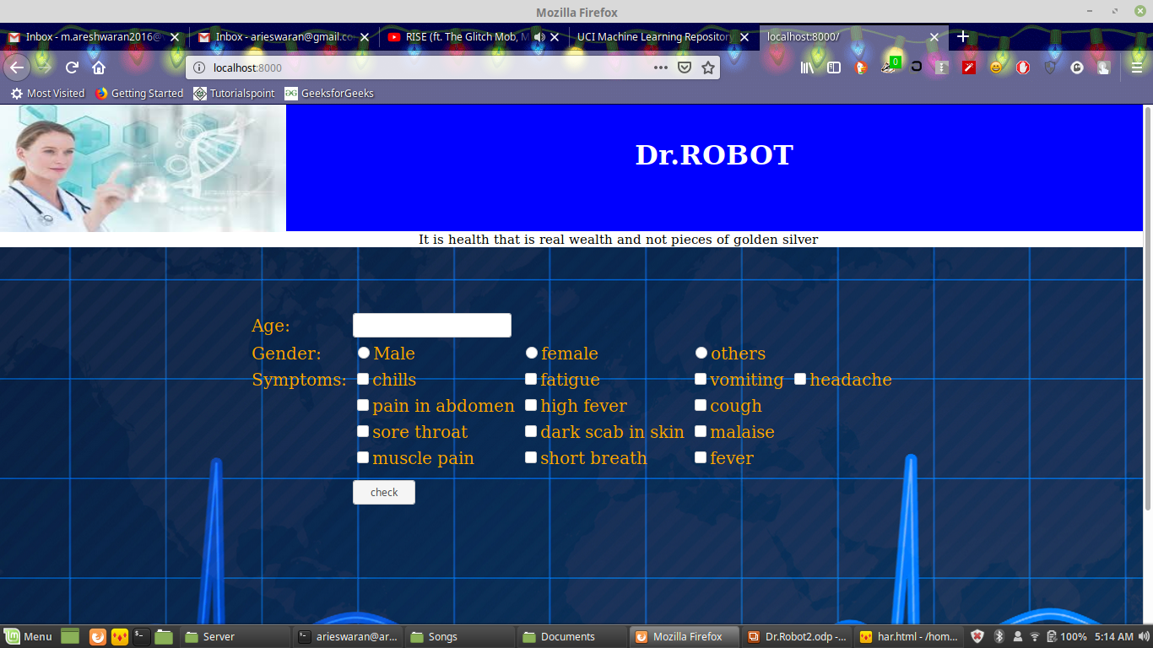
The System

Slide 8
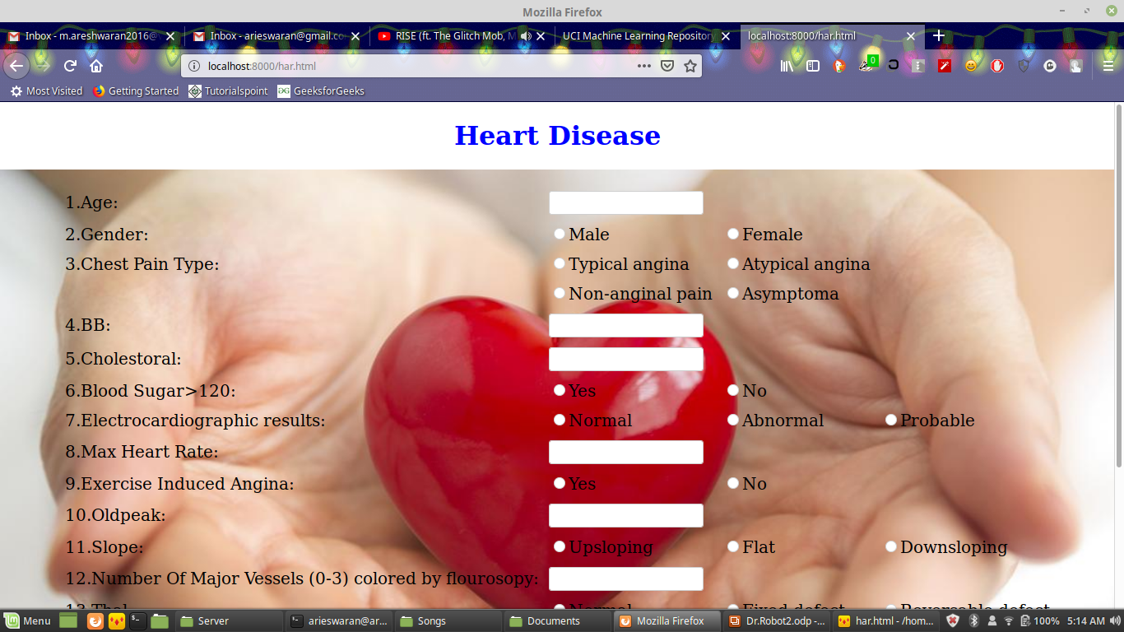

Slide 9
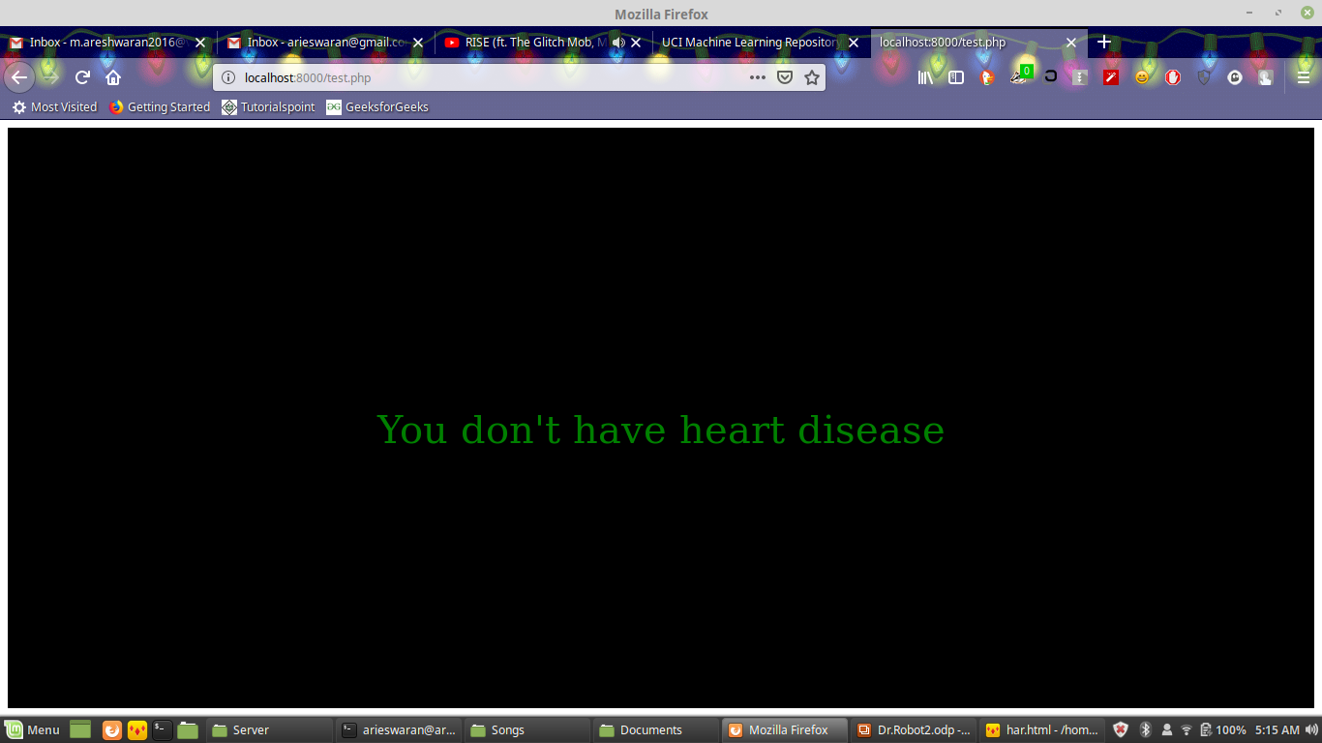

Slide 10
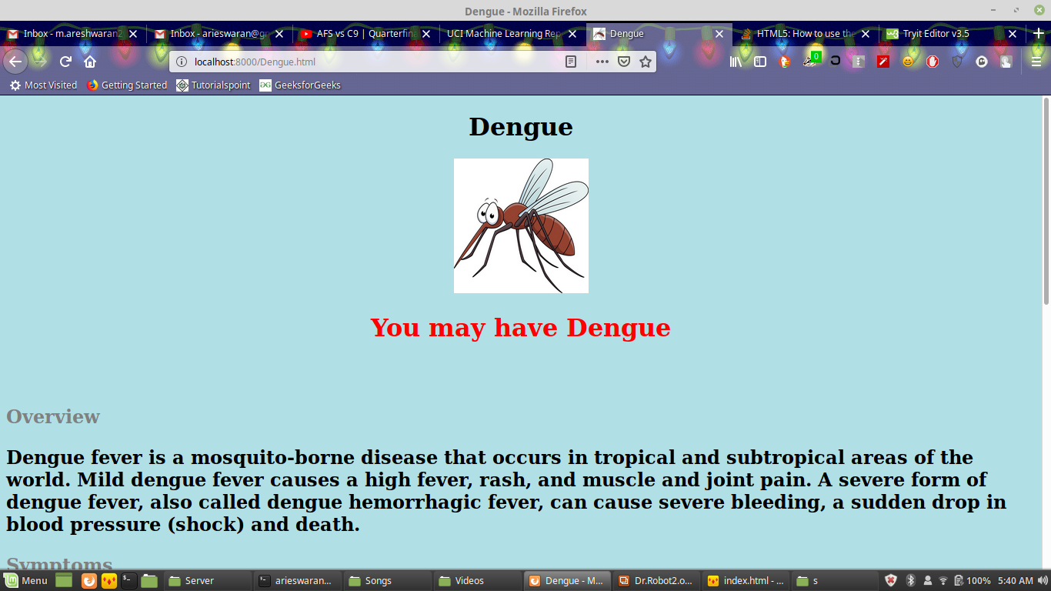

Slide 11
